Slide 1


QUOC-ANH NGUYEN
2021-11-22

Slide 2
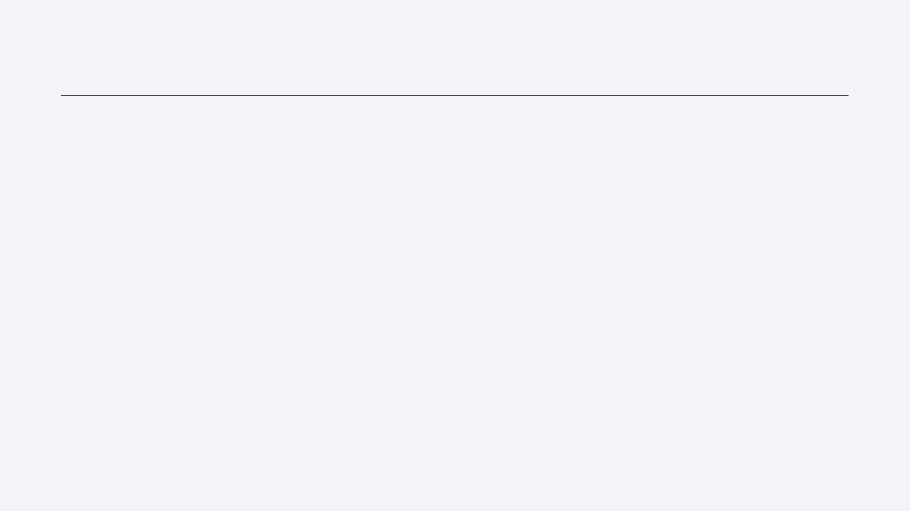
Outline
Executive Summary
Introduction
Methodology
Results
Conclusion
Appendix

Slide 3
Executive Summary
Summary of methodologies
Collect data from SpaceX API and Wikipedia
Verify, clean and transform data
Exploratory data analysis using SQL and visualization
Perform predictive analysis using classification models: KNN, Logistic Regression, SVM and Decision Tree
Summary of all results
Launch sites are located near coastline, highways and railroads, far away from cities
KSC LC-39A is the launch site have the most successful launches and highest successful launch rate
FT booster version has the highest successful rate
Best model can predict the outcome with 83% accuracy

Slide 4
Introduction
Objective:
Using the Space X launch data to get an insight for the Space Y project
Information that helps Space Y increase the first-stage reuse rate
Question to be answer:
Which factor help increasing the reuse rate?
What is the chance of reusing the first stage of a rocket before it launch?

Slide 5


Slide 6
Methodology
Executive Summary
Data collection methodology:
SpaceX open data API or Web scraping from Wikipedia
Perform data wrangling
Verify and clean data
Standardize outcome to value 0 or 1
Perform exploratory data analysis (EDA) using visualization and SQL
Perform interactive visual analytics using Folium and Plotly Dash
Perform predictive analysis using classification models:
Using Grid Search and Cross Validation to finetune the models (KNN, Logistic Regression, SVM, Decision Tree)

Slide 7
Data Collection
Dataset is collected using two methods:
Using SpaceX API: https://api.spacexdata.com/v4/launches/past
Web scraping: https://en.wikipedia.org/w/index.php?title=List_of_Falcon_9_and_Falcon_Heavy_launches
SpaceX API
Web scraping
Request
Parse
Request
Extract
Save
Filter data
Save
Parse

Slide 8
Data Collection – SpaceX API
Request the SpaceX launch data using the GET request
Parse the response to create a data table
Filter the data to only include Falcon 9 launches
Save the collected data
Reference file on GitHub
Collect data from SpaceX API
Request
Parse
Save
Filter data

Slide 9
Data Collection - Scraping
Request the Falcon 9 Launch Wiki page
Extract the required table from the response
Parse the HTML table to a data table
Save the collected data
Reference file on GitHub
Collect data using web scraping
Request
Extract
Save
Parse

Slide 10
Data Wrangling
Check for null values and data types
Calculate the number of launches on each launch site and number of each orbit
Calculate the occurrence of mission outcome
Create a landing outcome label
Reference file on GitHub
Check for nulls
Check for data type
Launches by orbit
Launches by launch site
Occurrence of mission outcome
Label outcome

Slide 11
EDA with Data Visualization
Scatter chart: visualize the output distribution showing how the variables affect the outcome.
Concerned variables: Payload mass, Flight number, Launch site, Orbit type
Line chart: showing how the success rate change over time.
Bar chart: visualize the success rate differences between Orbit types
Reference file on GitHub

Slide 12
EDA with SQL
List all launch sites
Display 5 records where Launch site begin with ‘CCA’
Display total mass carried by boosters launched by NASA (CRS)
Display average payload mass carried by booster version F9 v1.1
All the boosters which have success in drone ship and payload between 4000 kg and 6000 kg
The date when the first successful landing in ground pad achieved
Total number of successful and failure mission outcomes
The boosters which have carried the maximum payload mass
Date. launch site, booster of the failed landing in drone ship
Rank the count of landing outcome between the date 2010-06-04 and 2017-03-20
Reference file on GitHub

Slide 13
Build an Interactive Map with Folium
Circles and launch site name as marker added to show where all the launch sites are located
A marker cluster of every launch showing how many launches (successful and failed) at each launch site.
Lines showing the distances from a launch site to coastline, railroad, highway and city
Reference file on GitHub

Slide 14
Build a Dashboard with Plotly Dash
A dropdown menu to select launch site for visualization
A pie chart showing success launch rate for launch sites to see the highest percentage of outcome compares to the others
A slider to select the range of payload mass
A scatter plot showing the distribution of mission outcome by payload mass and booster version.
Reference file on GitHub

Slide 15
Predictive Analysis (Classification)
Rescale the input using standardize scaler
Split train and test set with the ratio 8:2
Using grid search for each classification models with difference parameter to find the best version of each model.
Cross validation is used to validate each models
4 best models will be compared using test set, the model with the best accuracy will be selected
Reference file on GitHub
Standardize
Train/test split
Parameter dictionaries
Grid Search, Cross Validation
Classification models
Final model
4 best models

Slide 16
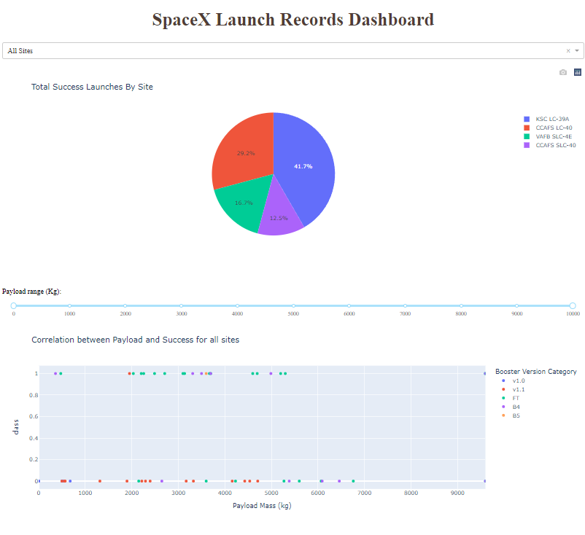
Results
Launch sites are located near coastline, highways and railroads, far away from cities
KSC LC-39A is the launch site have the most successful launches and highest successful launch rate
FT booster version has the highest successful rate
Best predictive model is LR with test score 83.33%

Slide 17


Slide 18
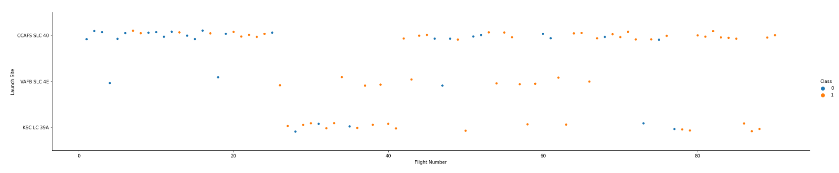
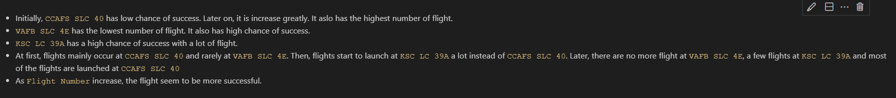
Flight Number vs. Launch Site

Slide 19
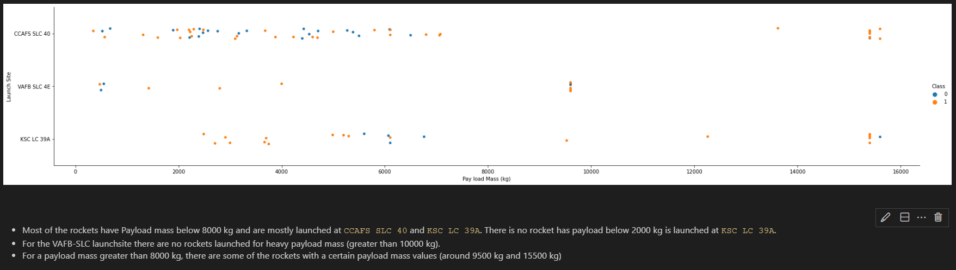
Payload vs. Launch Site
Show a scatter plot of Payload vs. Launch Site
Show the screenshot of the scatter plot with explanations

Slide 20
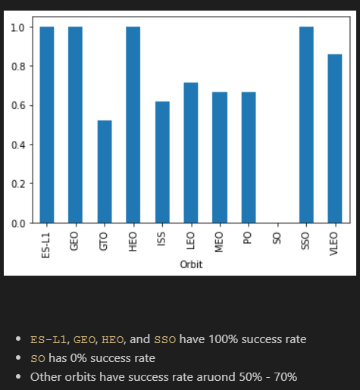
Success Rate vs. Orbit Type

Slide 21
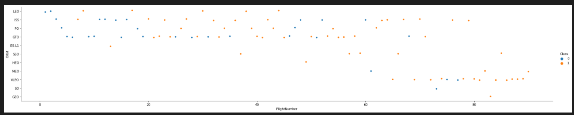
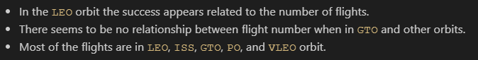
Flight Number vs. Orbit Type

Slide 22
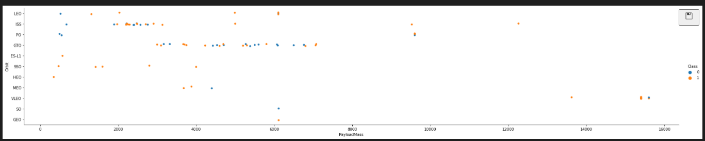
Payload vs. Orbit Type

Slide 23
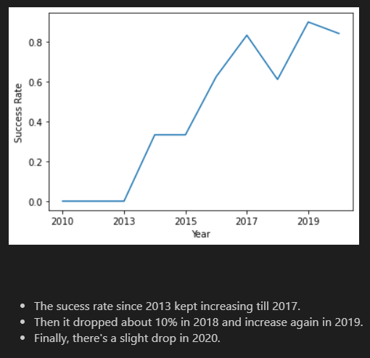
Launch Success Yearly Trend

Slide 24
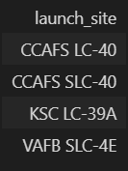
All Launch Site Names
There are 3 launch sites
CCAFS LC-40 changed its name to CCAFS SLC-40

Slide 25
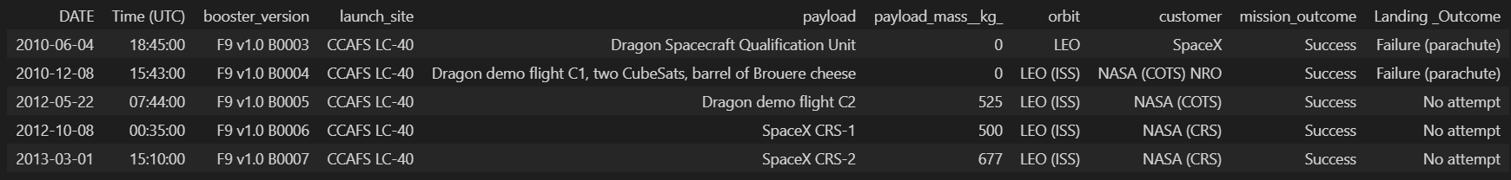
Launch Site Names Begin with 'CCA'
Five launches at CCAFS LC-40 are all successful but failed to land
All the launches have low payload mass and orbit in LEO
All the launches use different booster verions

Slide 26
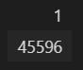
Total Payload Mass
Total payload mass carried by boosters launched by NASA is 45596 kg

Slide 27
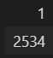
Average Payload Mass by F9 v1.1
Average payload mass carried by F9 v1.1 is 2534 kg

Slide 28
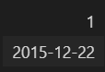
First Successful Ground Landing Date
First successful ground landing was 2015, Dec 22nd

Slide 29
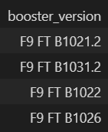
Successful Drone Ship Landing with Payload between 4000 and 6000
There are only 4 boosters which have success in drone ship and have payload mass greater than 4000 kg and less than 6000 kg

Slide 30
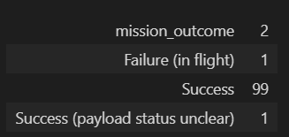
Total Number of Successful and Failure Mission Outcomes
There are mission outcome: success and failure
There’s only 1 failure mission which is failure in flight
100 successful mission. In that, there’s one mission with unclear payload status

Slide 31
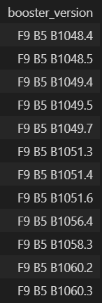
Boosters Carried Maximum Payload
There are 12 boosters that carried the maximum payload and they’re all F9 B5

Slide 32
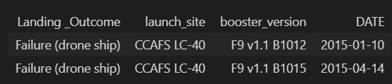
2015 Launch Records
In 2015, there are two failed landing in drone ship. They are all launches at CCAFS LC-40

Slide 33
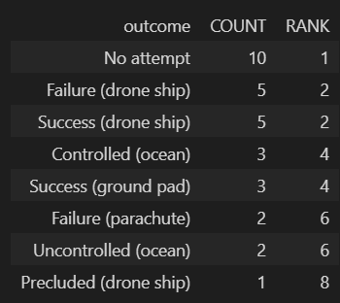
Rank Landing Outcomes Between 2010-06-04 and 2017-03-20
There are 8 outcomes between 2010-06-04 and 2017-03-20
The most occurred outcome is “No attempt”
Two of them are success

Slide 34


Slide 35
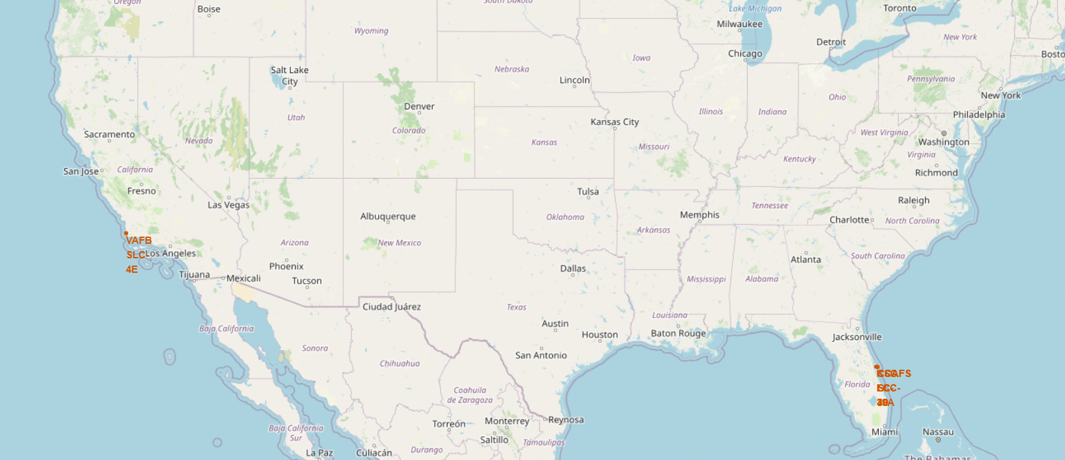
Launch site location
All the launch site are located near the coast
KSC LC-39A is close to CCAFS SLC-40/CCAFS LC-40

Slide 36
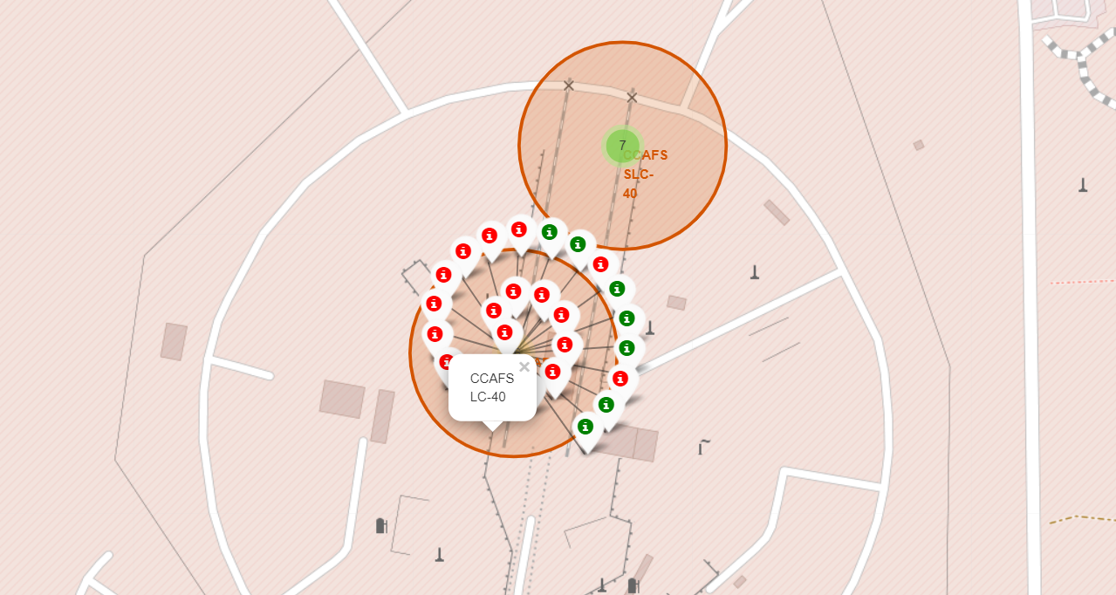
Mark launch result for each site
Green markers show the successful outcome and red ones shows failed outcome
CCAFS LC-40 has low chance of success but increase overtime (from inside to outside)

Slide 37
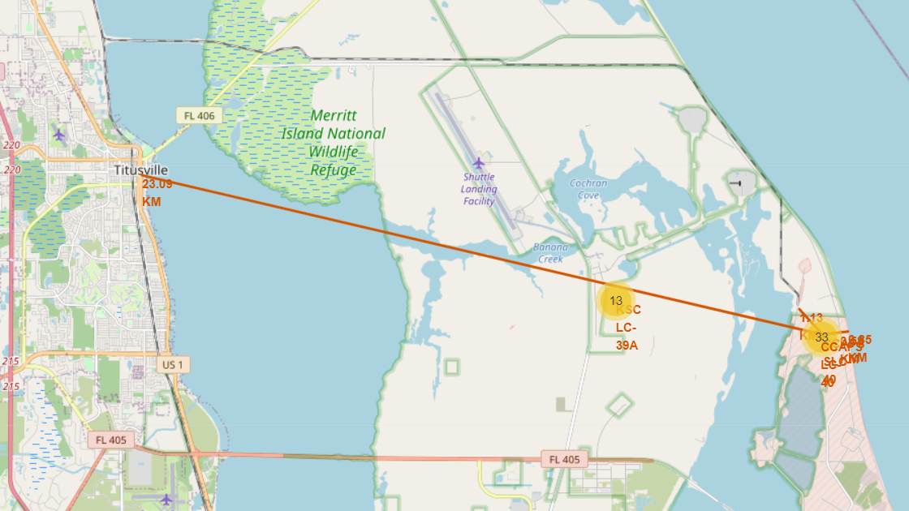
The distances between a launch site to its proximitie
Distance from CCAFS SLC-40 to
Coastline: 0.85 km
Railway: 1.13 km
Highway: 0.58 km
City (residential area): 23.09km

Slide 38


Slide 39
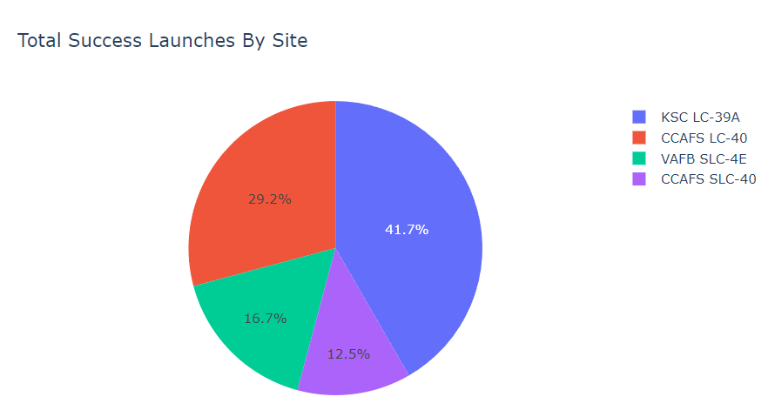
Total success launches by site
KSC LC-39A has the highest percent of success launches (41.7% of all success launces)
CCAFS LC-40 and CCAFS SLC-40 also add up to 41.7% of all success launches (CCAFS LC-40 got its name changed to CCAFS SLC-40)

Slide 40
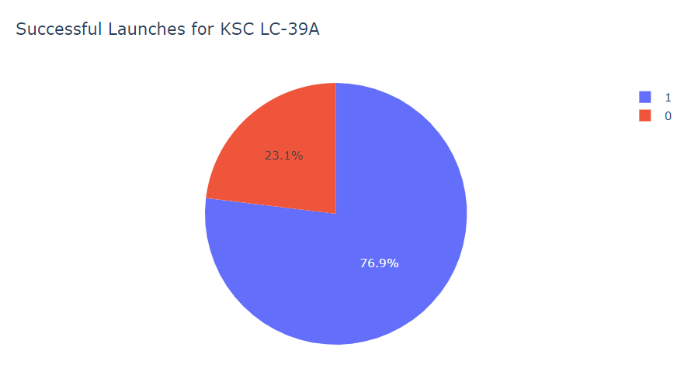
Launch success ratio
KSC LC-39A also has the highest success launch ratio (76.9% to 23.1%)

Slide 41
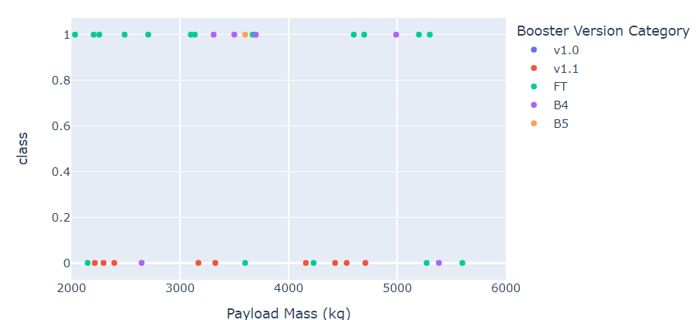
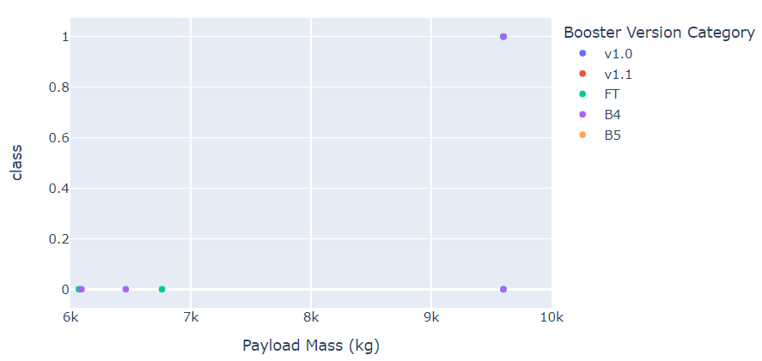
Correlation between Payload and Success
In range between 2000 kg and 6000 kg, boosters with version category of FT seems to have high successful chance while v1.1 seems to have high chance of failing.
With Payload more than 6000 kg, it is almost certain that the mission outcome will be failed.

Slide 42


Slide 43
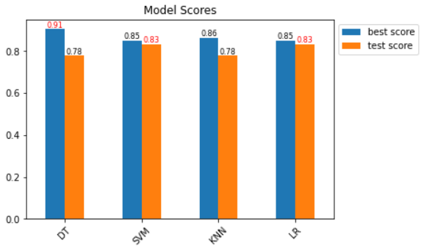
Classification Accuracy
SVM and LR are the best models with the same performance (83% test accuracy)
DT has the highest training accuracy but lower test score (overfitted).

Slide 44
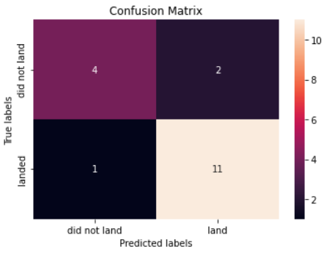
Confusion Matrix
SVM and LR result in the same confusion matrix
The models performed on the test dataset with 15 correct prediction, 3 incorrect prediction:
11 true positive, 4 true negative
2 false positive, 1 false negative

Slide 45
Conclusions
Launch sites are located near coastline, highways and railroads, far away from cities
KSC LC-39A is the launch site have the most successful launches and highest successful launch rate
FT booster version has the highest successful rate
Best predictive model is LR with test score 83.33%

Slide 46
Appendix
https://github.com/ngquocanh1197/Coursera-IBM-DS/tree/main/Course%2010

Slide 47


